Slide 1
Ethan J. Witt
Portfolio

Slide 2
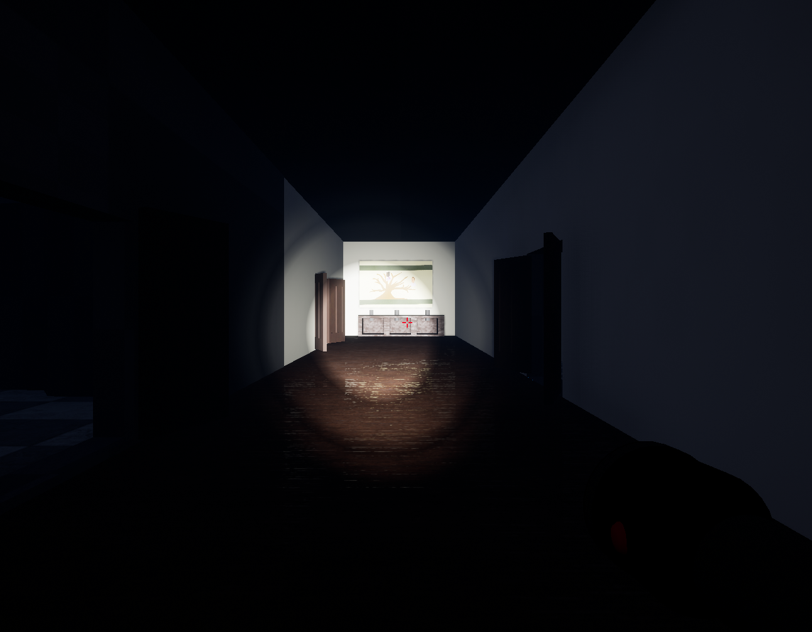
Clueless Murder Palace
(Unreal Engine 4)
Clueless Murder Palace came to be from a Global Game Jam competition (https://globalgamejam.org/2019/games/clueless-murder-palace) where participants are given 48-hours to create a game start to finish. The catch is the participants must create the game based on a theme that is unknown to the participants until the event begins. Our team created Clueless Murder Palace in 2019.
Description: “You are now the proud owner of that old Victorian house on the hill, all its contents, and its otherworldly residents. In order to make this house your home, help the ghosts that abound find peace, by placing objects of importance to them back where they belong, and removing objects that caused their demise. Based loosely on the board game Clue, use visual and audio clues to find the objects without angering the ghosts. Help the likes of General Catsup and Dr. Sauce find eternal peace.”

Slide 3
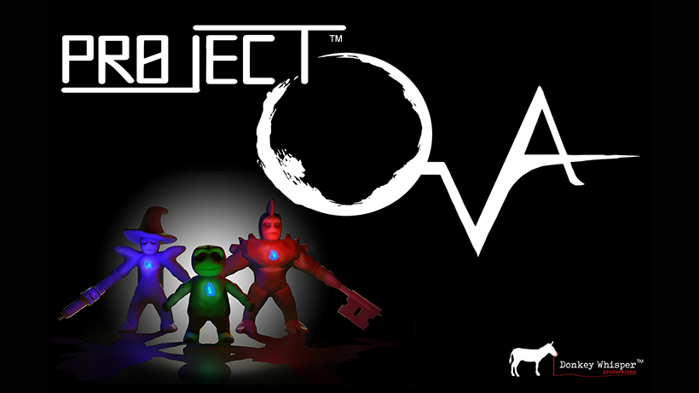
Project OVA
(Unreal Engine 4)
Currently in production by Donkey Whisper Productions
www.donkeywhisper.com
Description:
Project OVA is an action/adventure game with heavy puzzle and combat elements, and a strong focus on story. Viewing the world over the shoulder of their avatar, players will encounter interesting personalities, fight dangerous creatures, and solve challenging puzzles. Players can run, sneak, climb, craft, and fight as they explore the interesting home of Doctor Markov Dragunov, from the perspective of a 4-inch tall clay sculpture. Forged in the mind of Kumar Singh, the vast universe of Project OVA contains many secrets, colorful characters, and deep lore. Multiple themes of science fiction and fantasy collide to create a cyber-bio-punk wonderland for players to shape and explore.

Slide 4
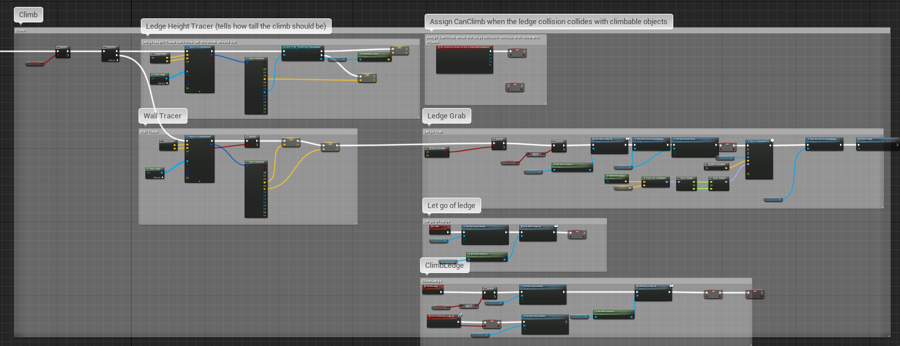
Project OVA
An example of Blueprints I created for Project OVA. This functionality is how the game processes when the character tries to climb up to a ledge.

Slide 5
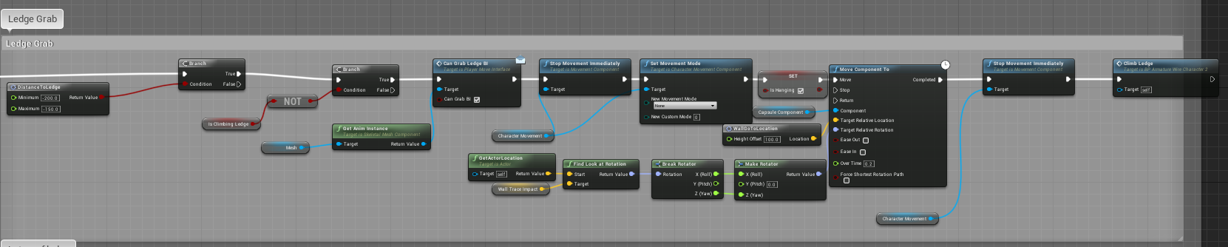
Project OVA
This is a more zoomed in view of some of the functionality for the Ledge Grab function.

Slide 6
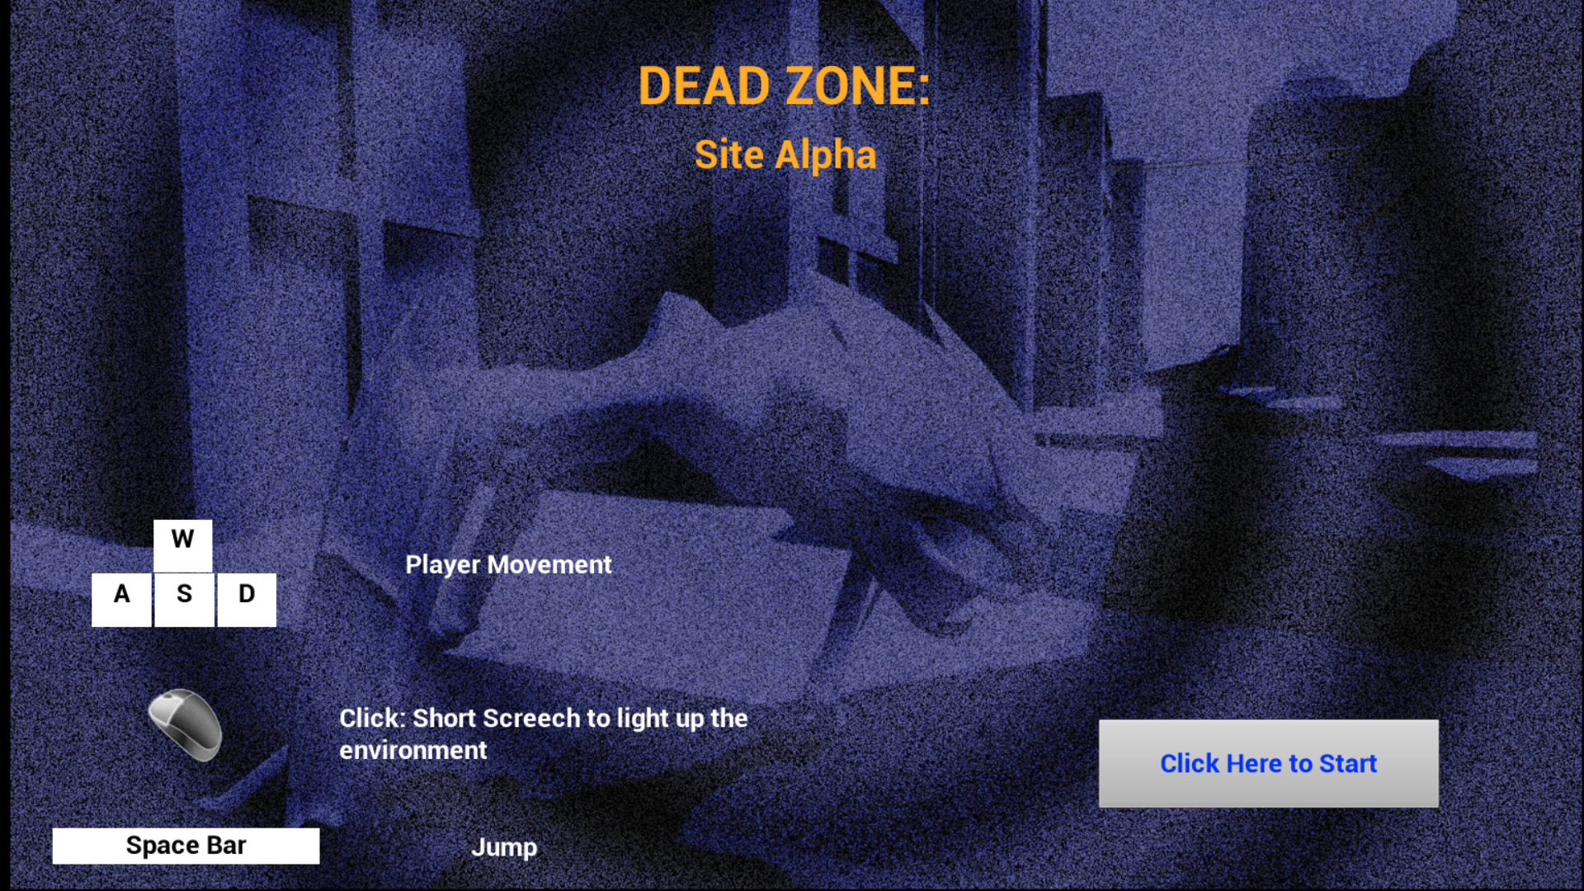
Dead Zone: Site Alpha
(Unreal Engine 4)
Dead Zone: Site Alpha was another Global Game Jam project where the team had 48-hours to create a game. The theme for this “Jam” was “Transmission.” In this case, we interpreted how sonar or echolocation can transmit sound and be interpreted in order to navigate the environment.
Description:
A sci-fi thriller game played from the point of view of an alien creature that uses echolocation to see. The alien species is one of many occupying Earth and is a master of stealth and must navigate an abandoned city and avoid the humans of the Resistance to take out a radio tower that has been broadcasting rebellious messages and information.

Slide 7
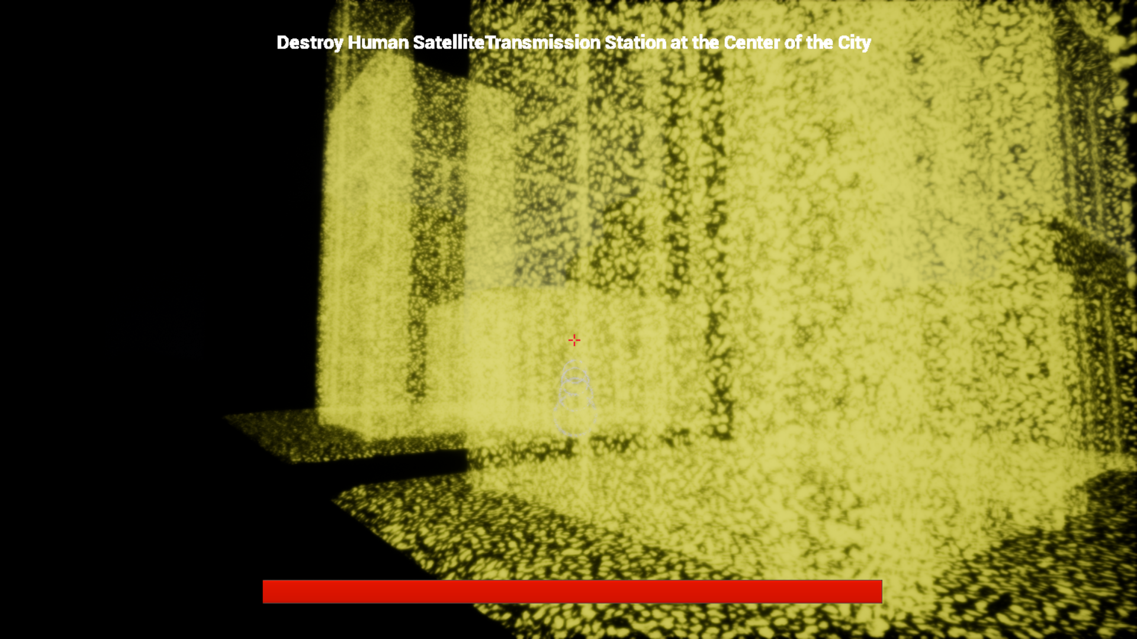
Dead Zone: Site Alpha
In the game, the player would press a button and the character produces a focused sound. Whatever the focused sound hit would illuminate briefly. The player had to navigate a city and avoid enemy patrols.

Slide 8
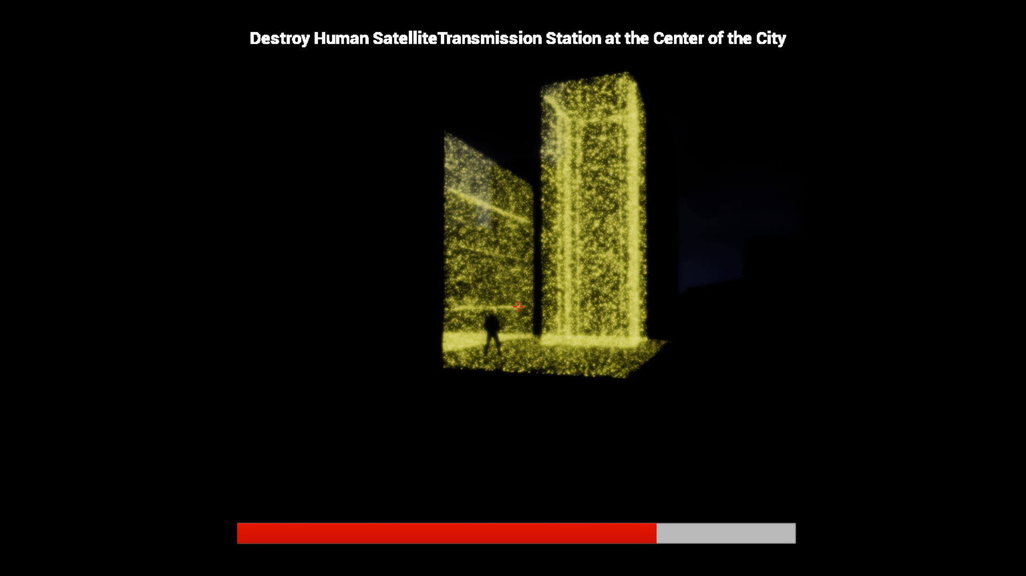
Dead Zone: Site Alpha
This is an example of the player running into an enemy patrol and losing health after being attacked.

